Slide 1
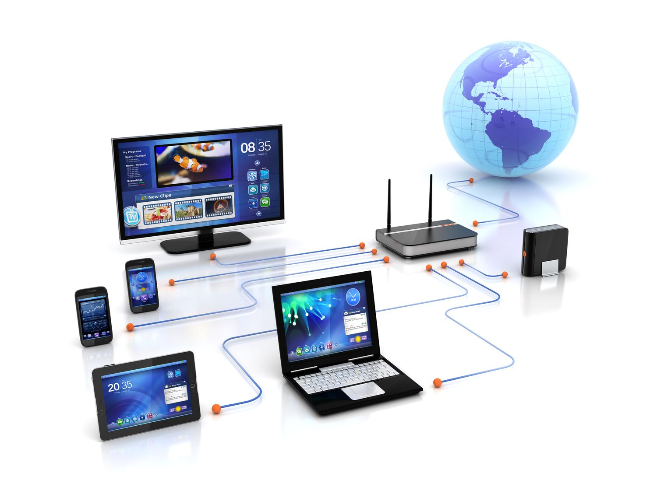
SC2008/CZ3006/CE3005 ​ Computer Network​

Slide 2
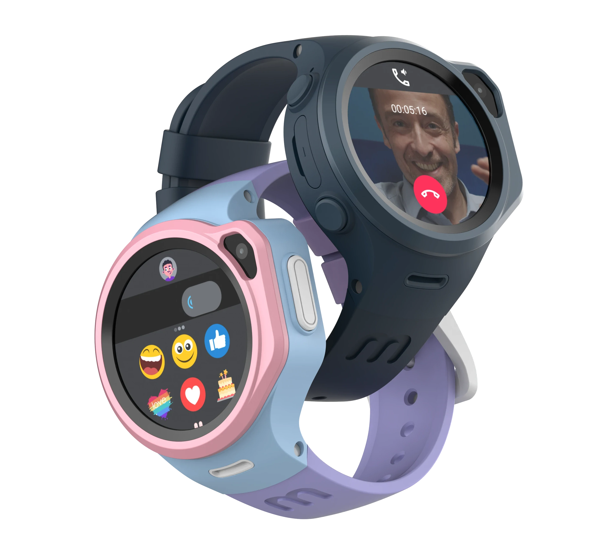

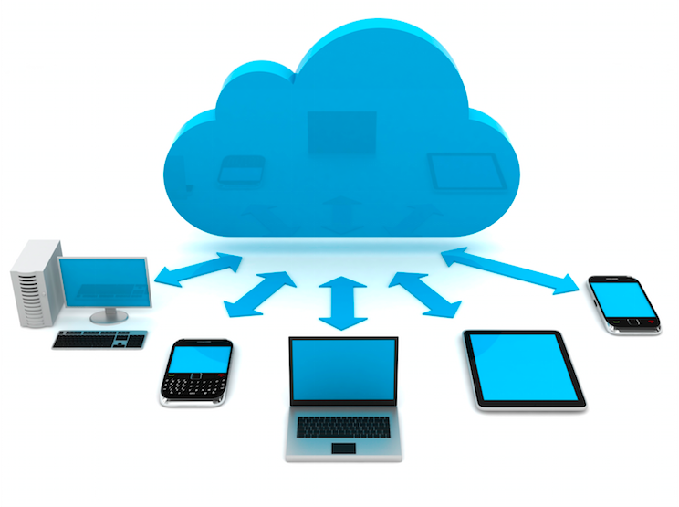

Where are computer networks now?
Cloud

Slide 3

SC2008/CZ3006/CE3005 ​ Computer Network​
Lecture 1
Course Logistics and Internet History

Slide 4
Contents
Course Logistics
Teaching staff
Lecture
Tutorial
Lab
Exam
A Brief History of Internet
How this thing gets started

Slide 5
Course Logistics

Slide 6
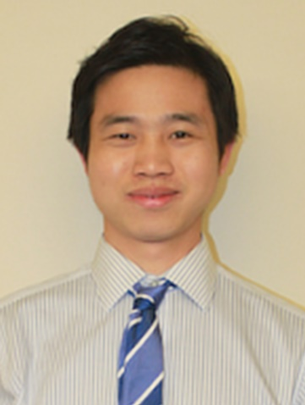
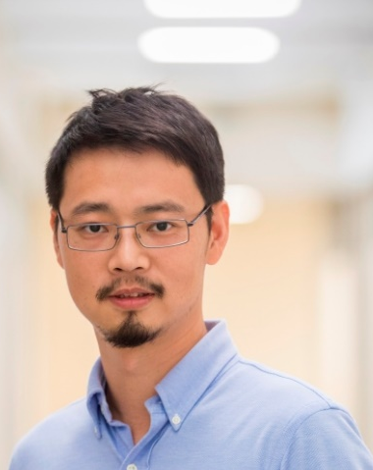
Teaching Staff
Lecturers
Dr. Jun ZHAO (Part I, before the recess week)
Dr. Mo LI (Part II, after the recess week)

Slide 7
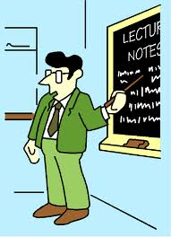
Lecture
Time/Location
Monday and Wednesday 9:30AM – 10:20AM, Lecture Theatre LT2A
LT2A is on the first floor of North Spine, between Block N3 and Block N4.
Two Parts
Part I: Weeks 1-6 (Jun ZHAO) Week 7 for E-Learning according to SCSE rules
Part II: Week 8-13 (Mo LI)
References
James K. Kurose and Keith W. Ross, Computer Networking: A Top-Down Approach https://eclass.teicrete.gr/modules/document/file.php/TP326/%CE%98%CE%B5%CF%89%CF%81%CE%AF%CE%B1%20(Lectures)/Computer_Networking_A_Top-Down_Approach.pdf
Douglas E. Comer, Computer Networks and Internets https://bmansoori.ir/book/Computer%20Networks%20and%20Internets.pdf

Slide 8
SC2008/CZ3006/CE3005 - Part I
Focusing on Underlying Layers
Physical layer resilience
Data link layer
Flow control
Error control
Local area network
MAC
Wireless LAN
Mobile access
Network architecture and performance
Network design patterns

Slide 9
SC2008/CZ3006/CE3005– Part II
Covering Higher-Level Layers
Applications
TCP protocol
IP protocol (main emphasis)
Routing process

Slide 10
Part I Syllabus – Fundamental Underlying Layers
Week​ | Date​ | Subject​
Week 1 | 9/Jan/2023​ | Introduction: Course Logistics and Internet History​
 | 11/Jan/2023​ | Layered Network Architecture​
Week 2 | 16/Jan/2023​ | Physical-layer Resilience
 | 18/Jan/2023​ | Data Link Layer: Flow Control​
Week 3 | 25/Jan/2023​ (no class on 23/Jan/2023, a holiday​) | Data Link Layer: Error Control​
Week 4 | 30/Jan/2023​ | Local Area Network: Introduction​
 | 01/Feb/2023​ | Local Area Network: Medium Access Control (MAC)​
Week 5 | 06/Feb/2023​ | Local Area Network: Ethernet​
 | 08/Feb/2023​ | Local Area Network: Ethernet Evolutions​
Week 6 | 13/Feb/2023​ | Wireless Local Area Network (WLAN): Overview and 802.11
 | 15/Feb/2023​ | First Part: WLAN’s Multi-Access Reservation Protocol (MARP); Second Part: A Brief Overview of Network Paradigms​
Week 7 | 20/Feb/2023 | Network Paradigms​: Circuit Switching versus Packet Switching
 | 22/Feb/2023 | Mobile Access Networks

Slide 11

Tutorial
Starting from the 3rd week
Try all the problems before the session
7 Tutorials for the whole course
6 for regular sessions
1 for E-learning
Problems & Questions
Exam questions from previous years
Problems asked by you

Slide 12
Instructors of Tutorials
Please check https://wish.wis.ntu.edu.sg/webexe/owa/aus_schedule.main for the time and location of your tutorial sessions.
Name​ | Tutorial groups​ | Email address​
Anwitaman Datta​ | A45, A57, A58, X52 ​ | anwitaman@ntu.edu.sg​
Dusit Niyato​ | A26, A33, A53, A54 ​ | dniyato@ntu.edu.sg​
Mo LI​ | A21, A42, Z48 ​ | limo@ntu.edu.sg​
A S Madhukumar​ | A34, A35, A37 ​ | ASMadhukumar@ntu.edu.sg​
Lee Francis​ | A29, A51, A52, Z59, Z60 ​ | ebslee@ntu.edu.sg​
Rui TAN​ | A36, A41, Z21 ​ | tanrui@ntu.edu.sg​
Jun ZHAO​ | A50 ​ | junzhao@ntu.edu.sg​ ​
Jun LUO​ | A49, Z47 ​ | junluo@ntu.edu.sg​

Slide 13
Lab
For Groups in even weeks: Week 4 for Lab 1, Week 6 for Lab 2, Week 8 for Lab 3, Week 10 for Lab 4.
For Groups in odd weeks: Week 5 for Lab 1, Week 7 for Lab 2, Week 9 for Lab 3, Week 11 for Lab 4.
You can check the time and location at: https://wish.wis.ntu.edu.sg/webexe/owa/aus_schedule.main

Slide 14
Lab
4 Labs
Physical attendance is compulsory for labs.
Lab submissions are done via the NTULearn lab sites. (Use the NTULearn lab site, not the main course site.)
Online submission at the end of your lab session.
Marks of Labs (40% of your total score):
Lab 1: 10% of your total score
Lab 2: not graded (The purpose of Lab 2 is to practice programming, which will be useful for Lab 4).
Lab 3: 10% of your total score
Lab 4: 20% of your total score

Slide 15
Lab
4 lab sessions
Lab 1: Understanding Networking with Internet technology
Lab 2: Programming network application using socket (basically writing a UDP Quote of Day client).
Lab 3: Understanding Network Operations and Encapsulation by Sniffing and Analysing Network Packets
Lab 4: Analyzing Network traffic log data using Python.

Slide 16
Lab 4: Please start writing your code much time before the lab session.
Lab 4 is an assignment.
Students must prepare (write their code) before the laboratory session.
Students will be provided with the actual Network traffic data to analyse during the lab session.
The submission at the end of the lab session should include your code and also your answers to the lab questions.

Slide 17
Labs
Lab groups​ | Labs Instructors ​ | Lab Teaching Assistants
A37, A41, A42, A45, A52, Z21 Z47, Z48, Z59, Z60 | Assoc Prof Lee Francis​ ebslee@ntu.edu.sg​ | Premanand Rithwik (A41, A42, Z47, Z48)​ rithwik001@e.ntu.edu.sg​ Qian Liangxin (A37, A45)​ qian0080@e.ntu.edu.sg​ WhatsApp: 8790 6171 Si Peiyuan (A52)​ peiyuan001@e.ntu.edu.sg​ WhatsApp: 8032 4063 Xu Minrui (A26, Z21, Z59, Z60)​ minrui001@e.ntu.edu.sg​
A49, A50, A51, A53, A54, A57, A58, X52 ​ | Prof Li Mo​ limo@ntu.edu.sg​ | Dai Gaole (X52)​ gaole001@e.ntu.edu.sg​ Si Peiyuan (A49, A50, A51)​ peiyuan001@e.ntu.edu.sg​ WhatsApp: 8032 4063 Yu Wenhan (A53, A54, A57, A58)​ wenhan002@e.ntu.edu.sg​ WhatsApp: 92400174​
A21, A26, A29, A33, A34, A35, A36 ​ | Assoc Prof Zhao Jun​ junzhao@ntu.edu.sg​ ​ | Dai Gaole (A21)​ gaole001@e.ntu.edu.sg​ Lan Tianming (A33, A34, A35, A36)​ tianming001@e.ntu.edu.sg​ WhatsApp: 8039 4791 Qian Liangxin (A29)​ qian0080@e.ntu.edu.sg​ WhatsApp: 8790 6171

Slide 18
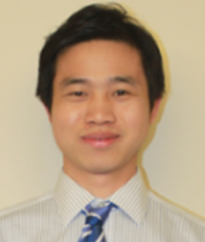

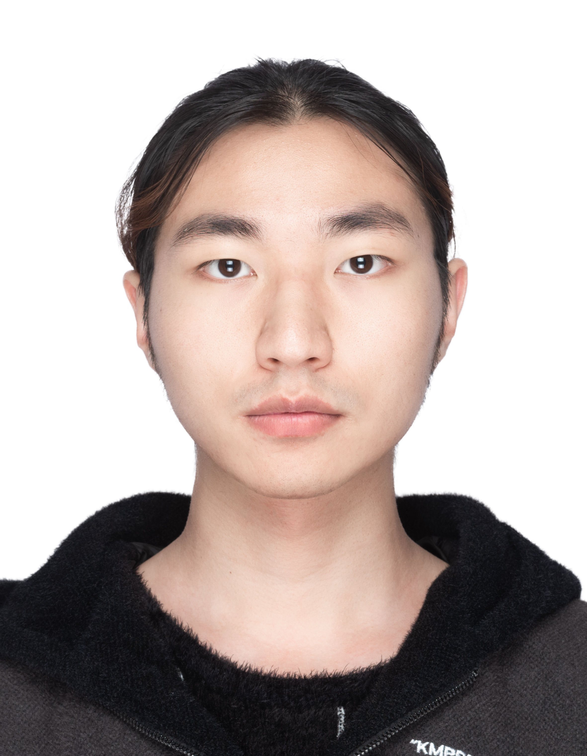
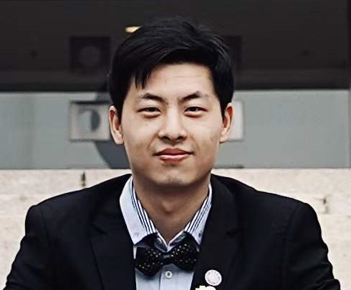
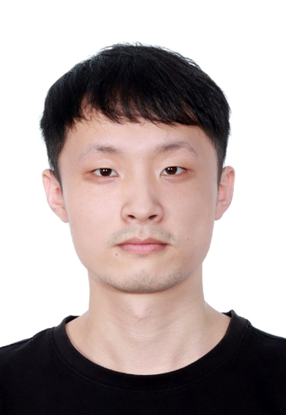
Office Hours (i.e., Consultation sessions) for Lectures/Labs/Tutorials
Role | Name | Office hours | Location | Email address | Phone/ WhatsApp number | Photo
Lecturer | Jun ZHAO | Thursday 2:30pm – 5:30pm | Tutorial Room (TR) 17, 5th floor of NS4 (North Spine) | junzhao@ntu.edu.sg | 8648 3534 (also WhatsApp number)
Teaching Assistants | Wenhan YU | Monday 2:30pm – 5:30pm | Computer Network Communication Lab (CNCL), N4-B2a-01 | wenhan002@e.ntu.edu.sg | 9240 0174
 | Liangxin QIAN | Tuesday 2:30pm – 5:30pm | CNCL, N4-B2a-01 | qian0080@e.ntu.edu.sg | 8790 6171
 | Tianming LAN | Wednesday 2:30pm – 5:30pm | CNCL, N4-B2a-01 | tianming001@e.ntu.edu.sg | 8039 4791
 | Peiyuan SI | Friday 2:30pm – 5:30pm | CNCL, N4-B2a-01 | peiyuan001@e.ntu.edu.sg | 8032 4063

Slide 19

Exam/Grade
No mid-term exam
One final exam (2 hours)
Score= Labs (~40%) + Exam (~60%)

Slide 20


How to ACE SC2008/CZ3006/CE3005
Attend Tutorial
Attend Lab
Attend Lectures
Keep your eyes open
Keep your ears open
Ask questions
You just talked about …, I am confused about …, can you explain again about …?

Slide 21

History of Internet

Slide 22





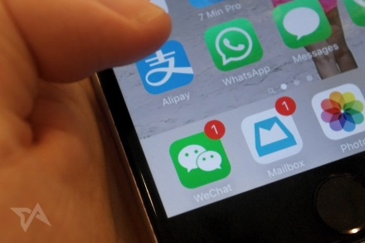

What is the Internet?
An inter-connected infrastructure for
information exchanging via standard protocols.
WWW
ftp
telnet
Email
Social networking
Crptocurrency
Metaverse

Slide 23
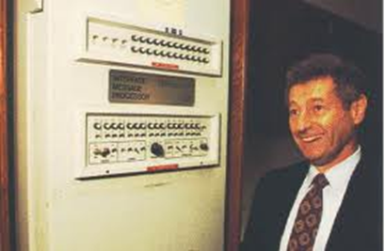
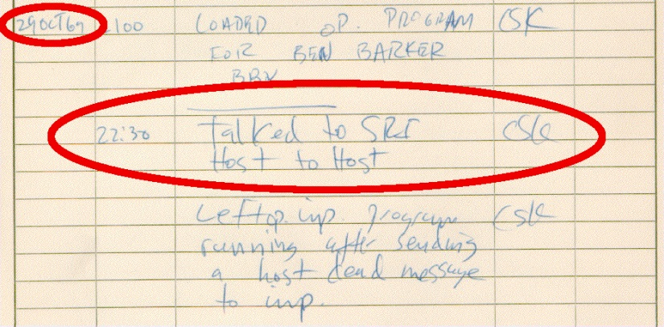
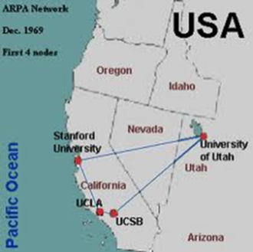
Where Did It Come From?
Early 1960’s - DARPA (ARPA in 1960’s) project headed by Licklider
Late 1960’s - ARPANET & research on packet switching by Lawrence Roberts
02/09/1969 – Leonard Kleinrock’s computer at UCLA became first node on the ARPANET
29/10/1969 – First packets sent; Charlie Kline attempted use of remote login from UCLA to SRI; system crashed as “G” was entered
05/12/1969 - Four nodes: UCLA, SRI, UCSB, University of Utah
Get more info at:
http://www.isoc.org/internet/history/
http://www.packet.cc/internet.html

Slide 24

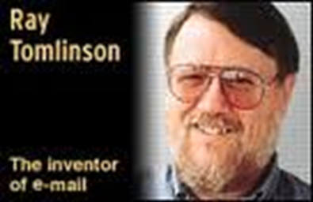
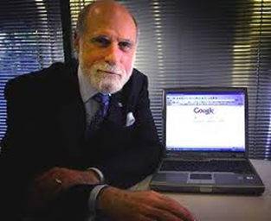
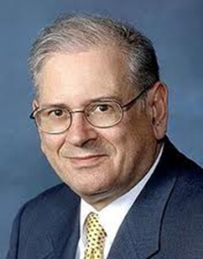
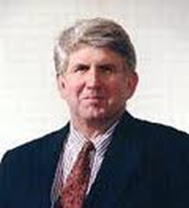
History of Internet
1969 – First RFCs by Steve Crocker (http://rfc.sunsite.dk/)
1971 – Email by Ray Tomlinson @ BBN
1970’s – Protocol development
1972-1974 TCP/IP developed by Vint Cerf & Bob Kahn
1973 – Ethernet by Metcalfe @ PARC
1974 TCP draft produced, split into TCP and IP in 1978
DNS – Distributed and scalable mechanism for resolving host names into IP addresses
UC Berkeley implements TCP/IP into Unix BSD
1985 – Internet used by researchers and developers

Slide 25
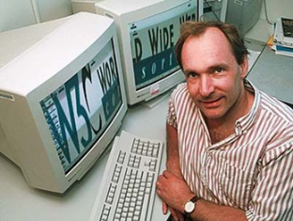

History of Internet
November 1988 – Internet worm affecting about 10% of the 60000 computers on the Internet (Robert Morris, Cornell)
Tim Berners-Lee at CERN
Proposal for WWW in 1989
First web page on November 13, 1990
Cisco(1984), Google (1998), Facebook(2004), Twitter(2006), Dropbox (2008), Instagram (2010), TikTok (2017), Trellix (2022)…
Global average Internet speed has increased dramatically from 14.4 Kbps in 1991 to 100 Mbps in 2022. In Singapore, you can expect nearly 300 Mbps as standard.

Slide 26
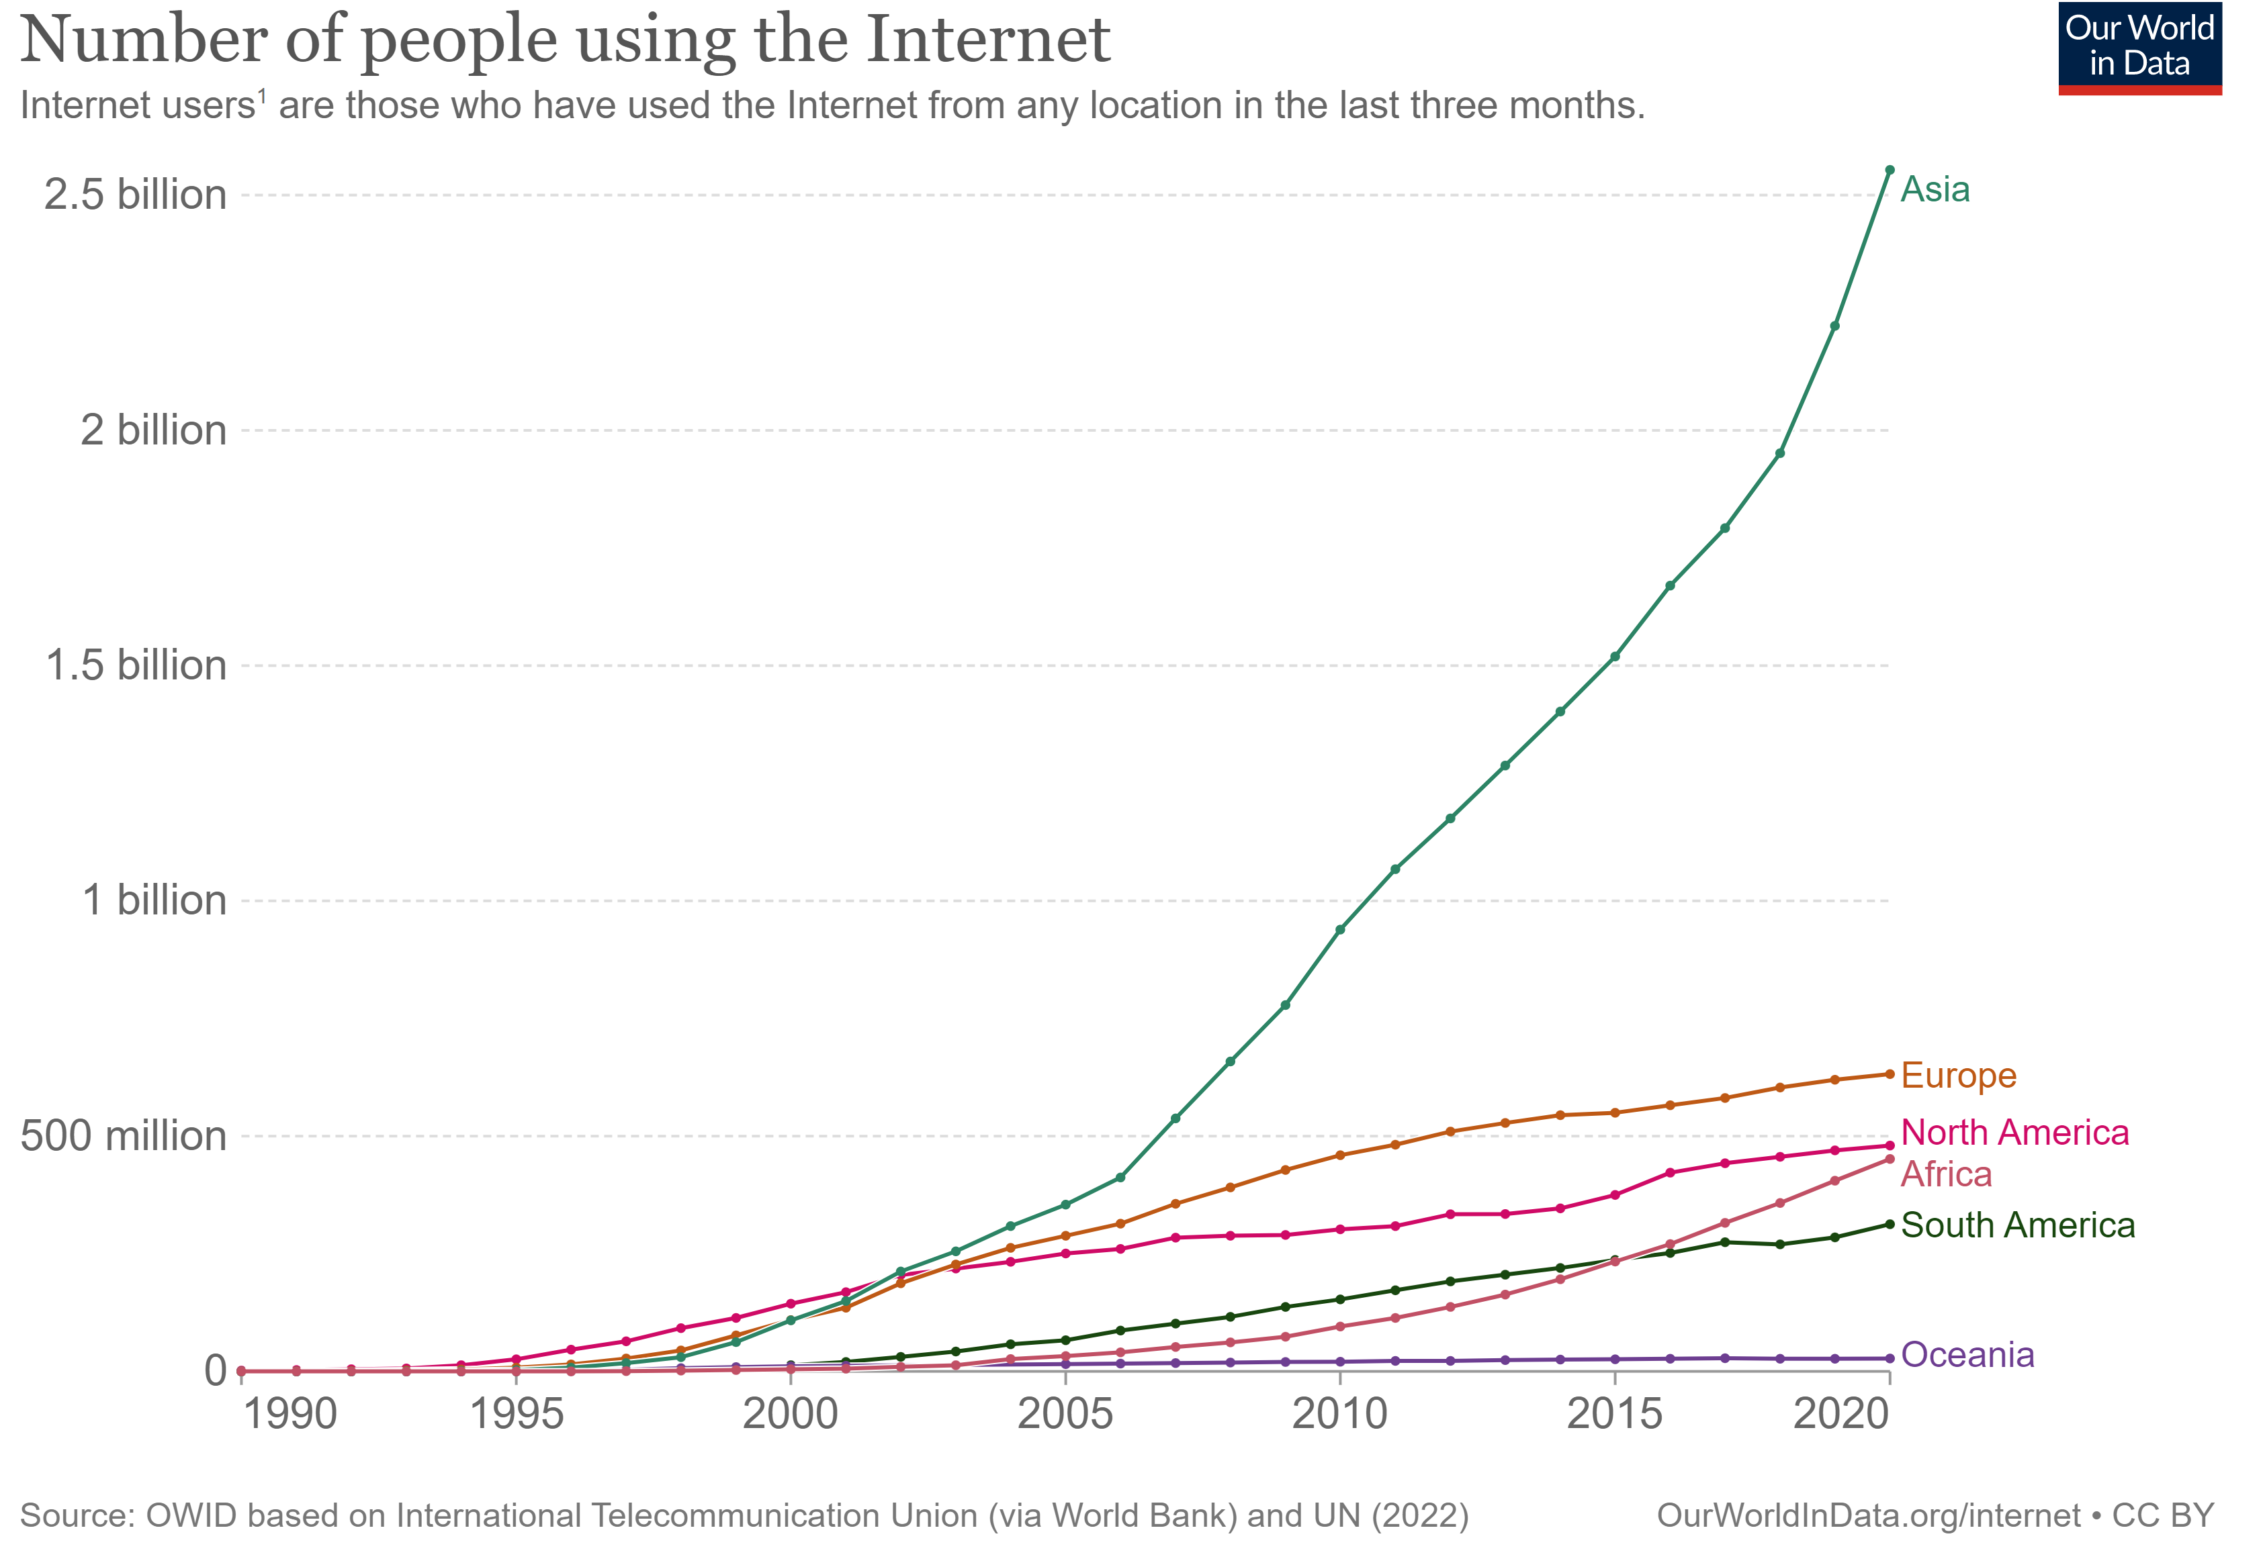
Internet Growth Trends

Slide 27


Internet Map
Father
Cerf
Kahn
Kleinrock
Metcalfe
Gore
Mother
Sally Floyd
http://internet-map.net

Slide 28

Internet Map
http://internet-map.net

Slide 29
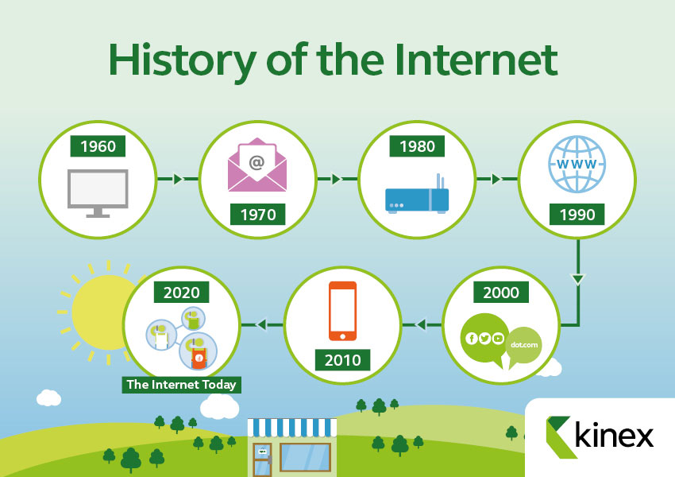
Brief History of the Internet

Slide 30
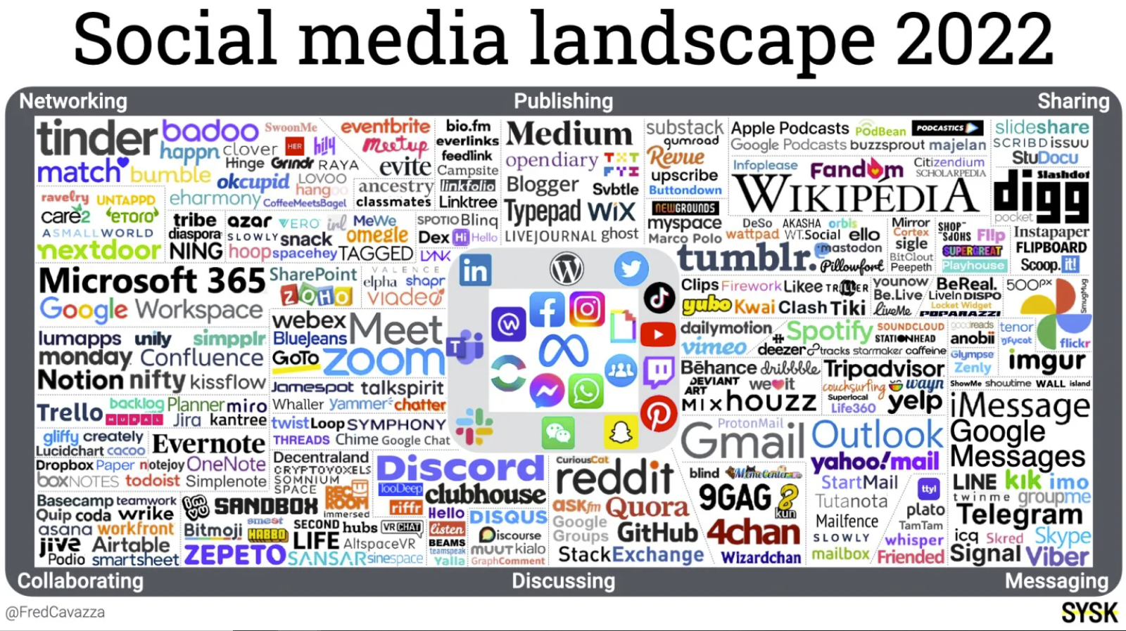
Internet Trends: Social Media

Slide 31
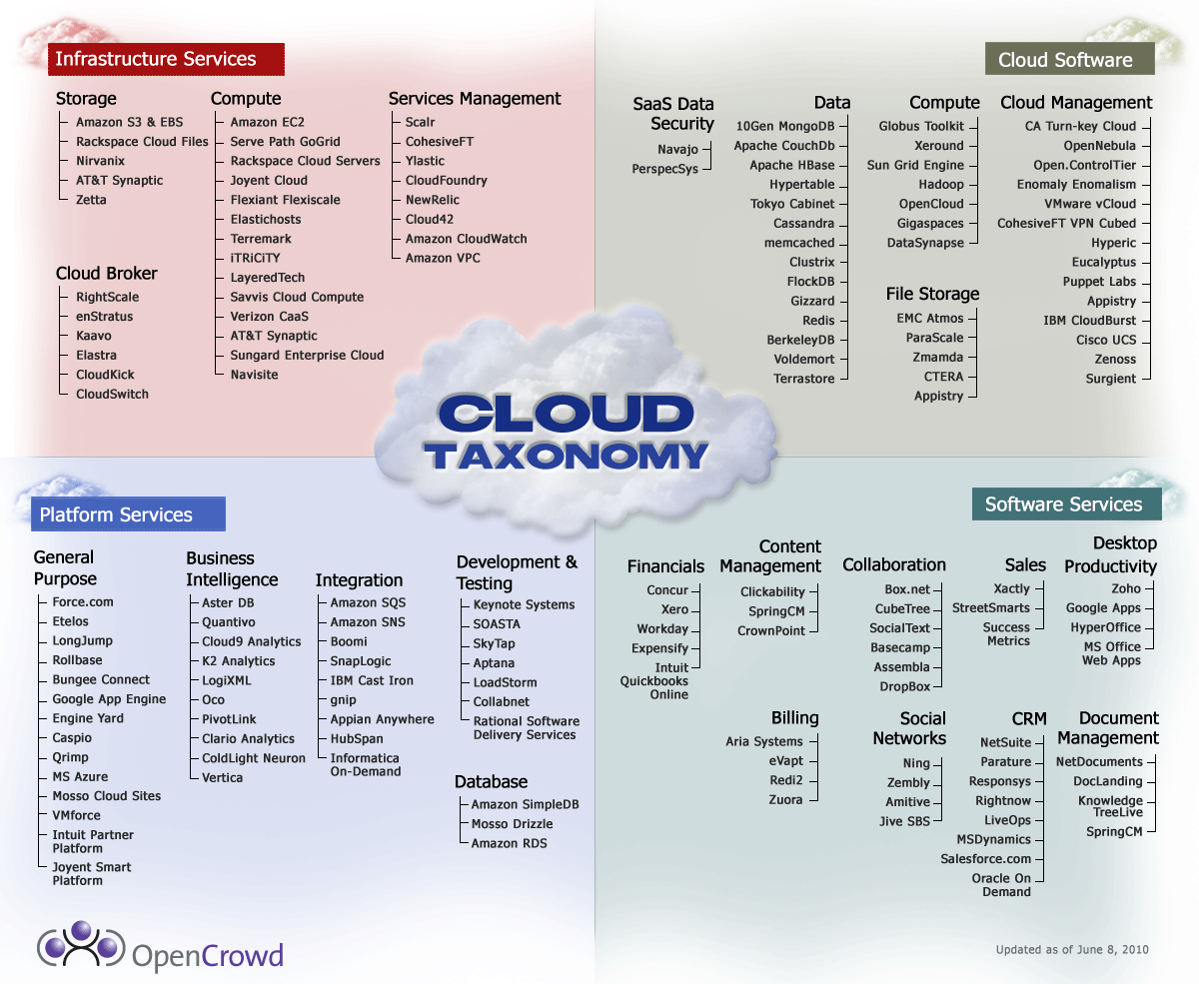
Internet Trends: Cloud Computing

Slide 32

Internet Trends: Big Data

Slide 33
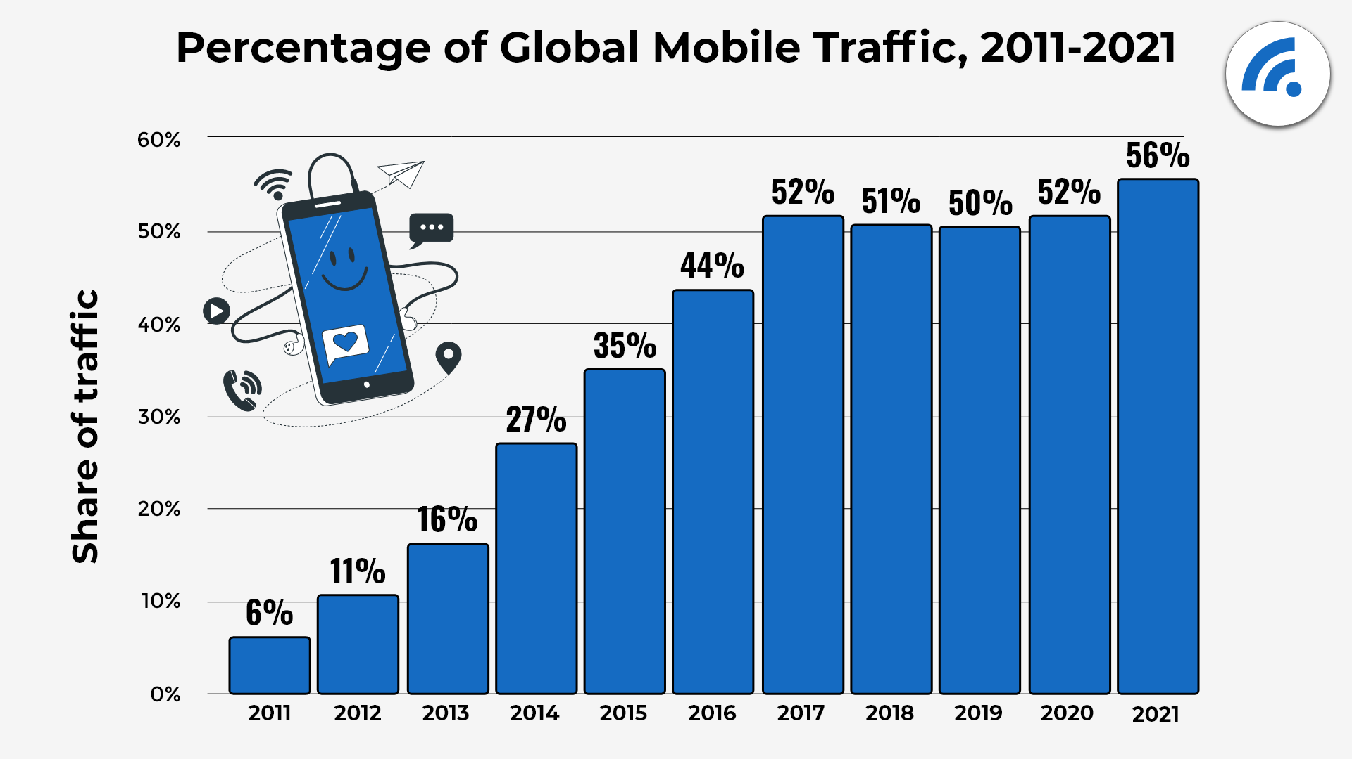
Internet Trends: Mobile Internet

Slide 34
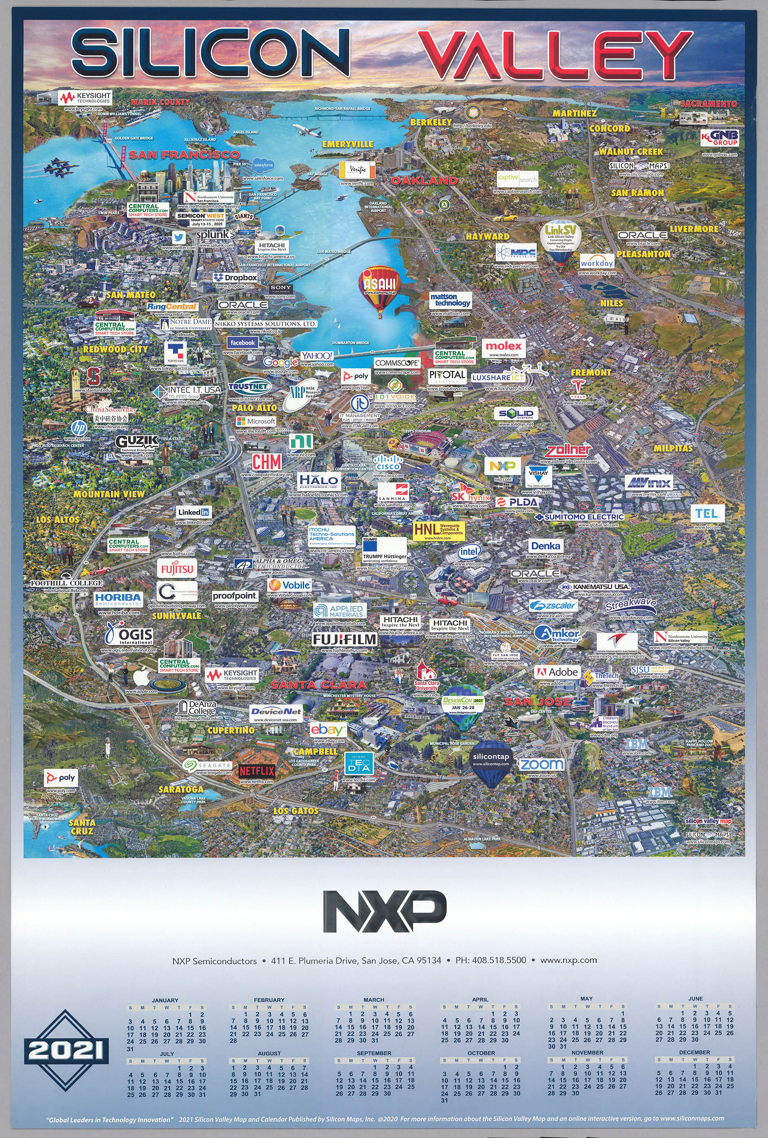
Hot Spot: Silicon Valley

Slide 35
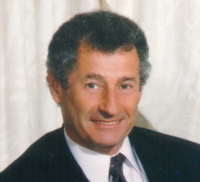
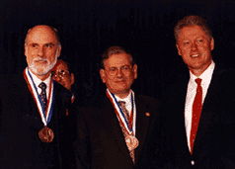
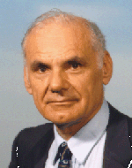
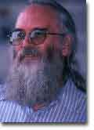
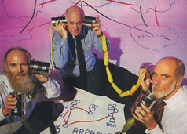

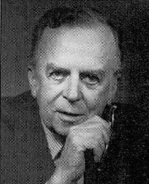
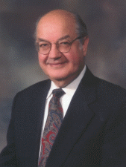

Lessons Learned
The Internet (and World Wide Web) we have today was created by some very bright, talented people who either had vision, or were inspired by other talented people’s visions.
Though their ideas were not always popular, they pressed ahead.
Their perseverance and hard work brought us to where we are today.
There is a lot to be learned by studying these people, their early work and keeping in mind what they had to work with.
We, engineers, should aim to solve practical problems. Luckily, we might become rich.

